Slide 1


Vodafone case study
Hazem Hamdy Hassanein

Slide 2
01
INTRODUCTION
LIST OF CONTENTS
02
CHALLENGES
03
SOLUTION
04
PREPROCESSING
05
PIE CHART
06
BAR CHART
07
TREND CHART

Slide 3

INTRODUCTION
This dataset provides a comprehensive view of employee activities, detailing metrics like Value, Cost, and Approval status. It enables the analysis of performance, task allocation, and cost-efficiency, with key categories such as 'Contracted Hours,' 'Allocated Hours,' and 'Remaining' highlighting workload and productivity. Additionally, it offers insights into organizational and regional performance, making it essential for optimizing resource use and evaluating how well employees meet their targets.

Slide 4
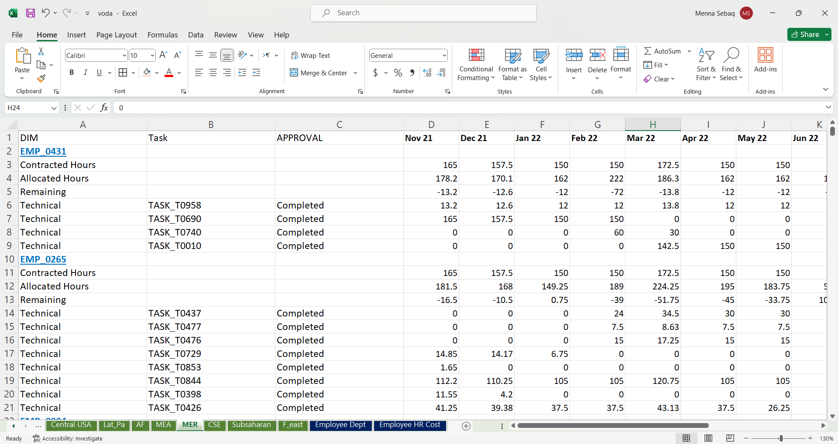
BEFORE RESHAPING
CHALLENGE

Slide 5
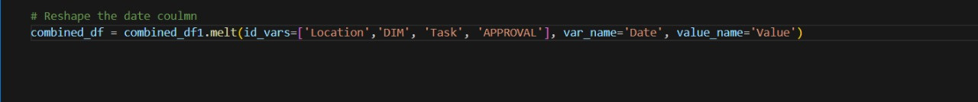
THE CODE TO RESHAPE
CHALLENGE
Reshape dates to make one date column

Slide 6
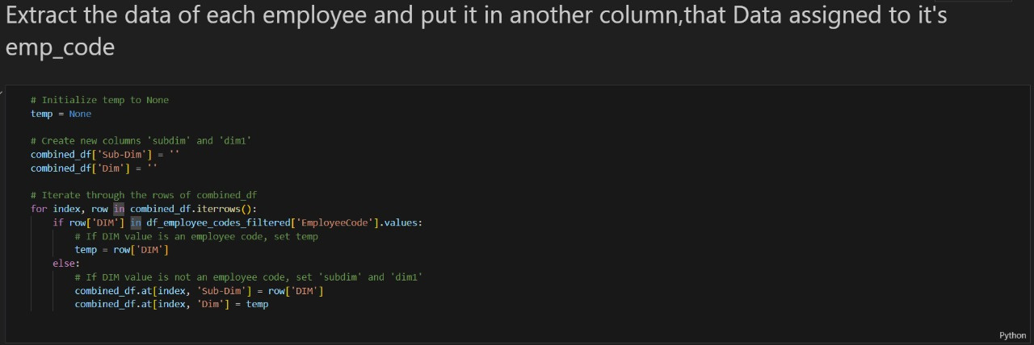
THE CODE TO RESHAPE
CHALLENGE
Reshape dates to make one date column

Slide 7
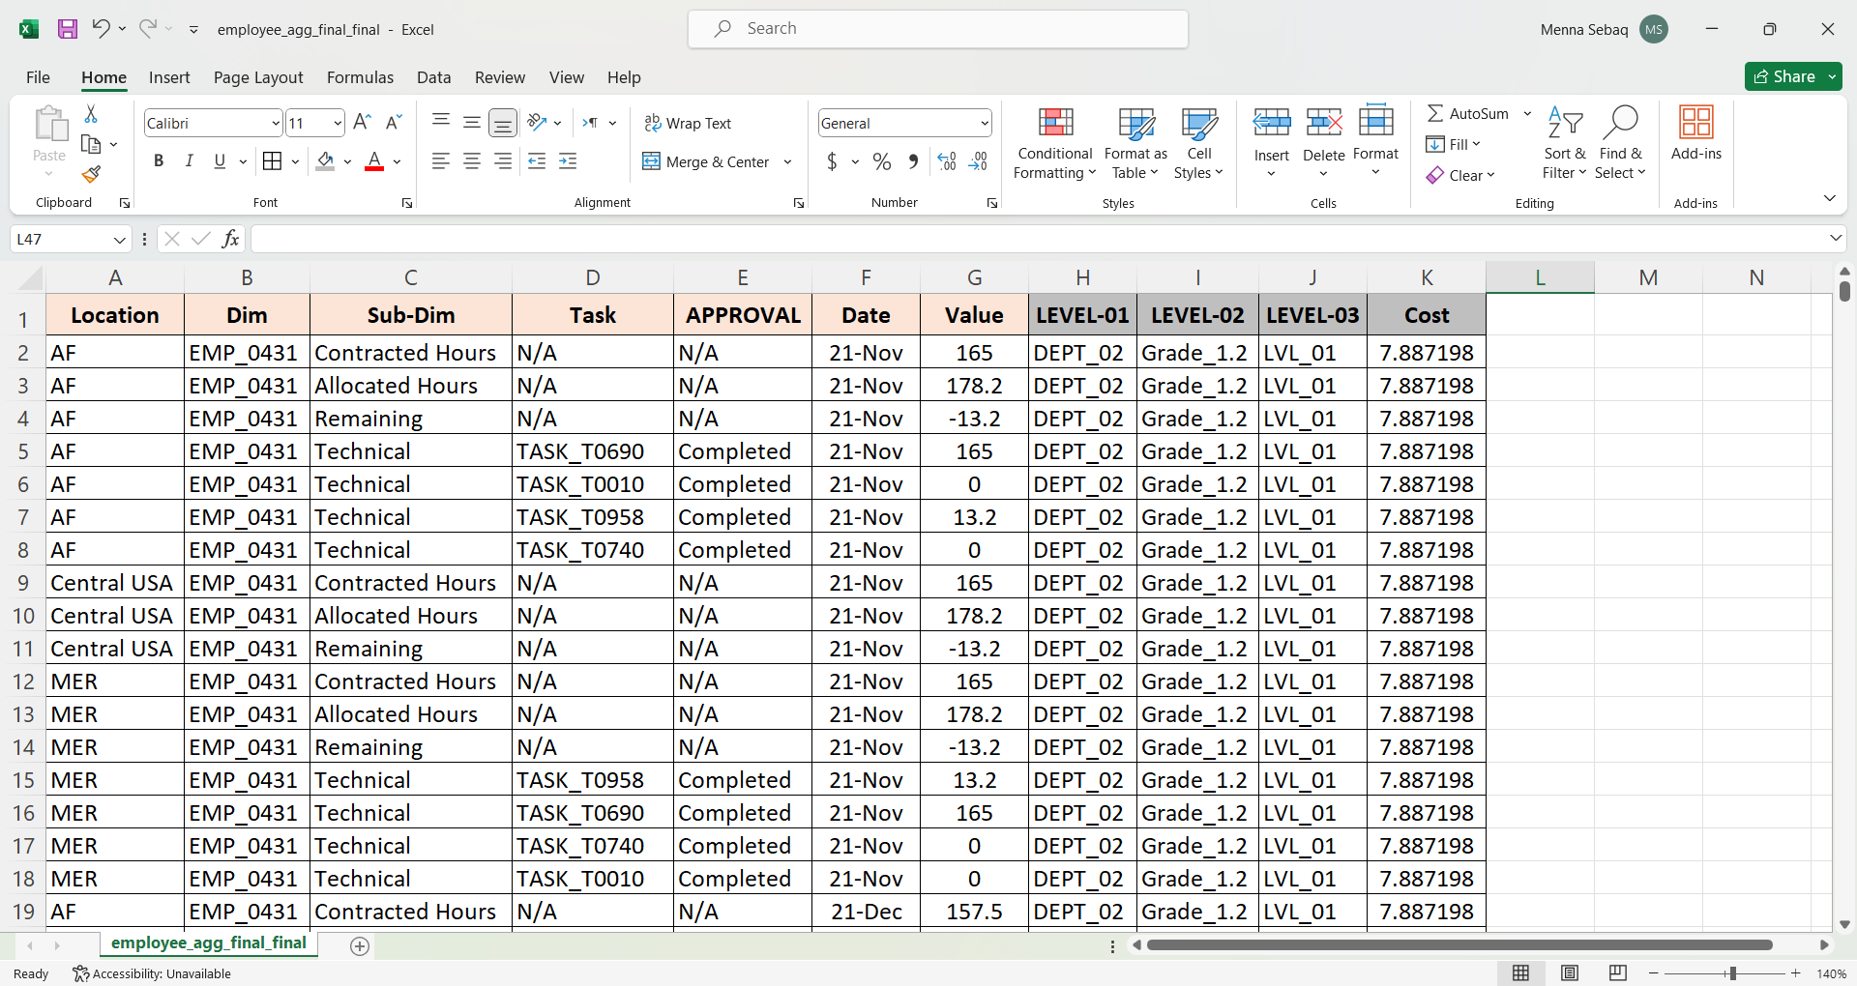
AFTER RESHAPING
SOLUTION

Slide 8
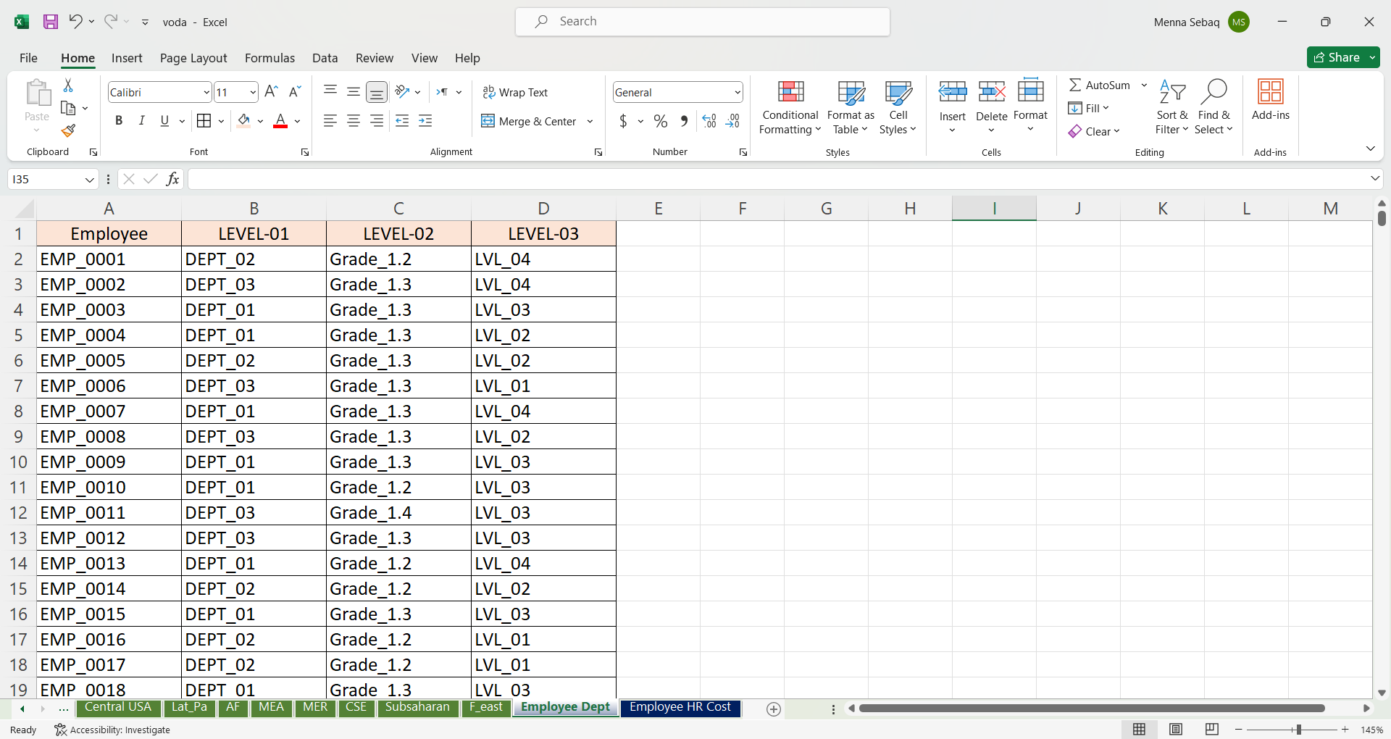
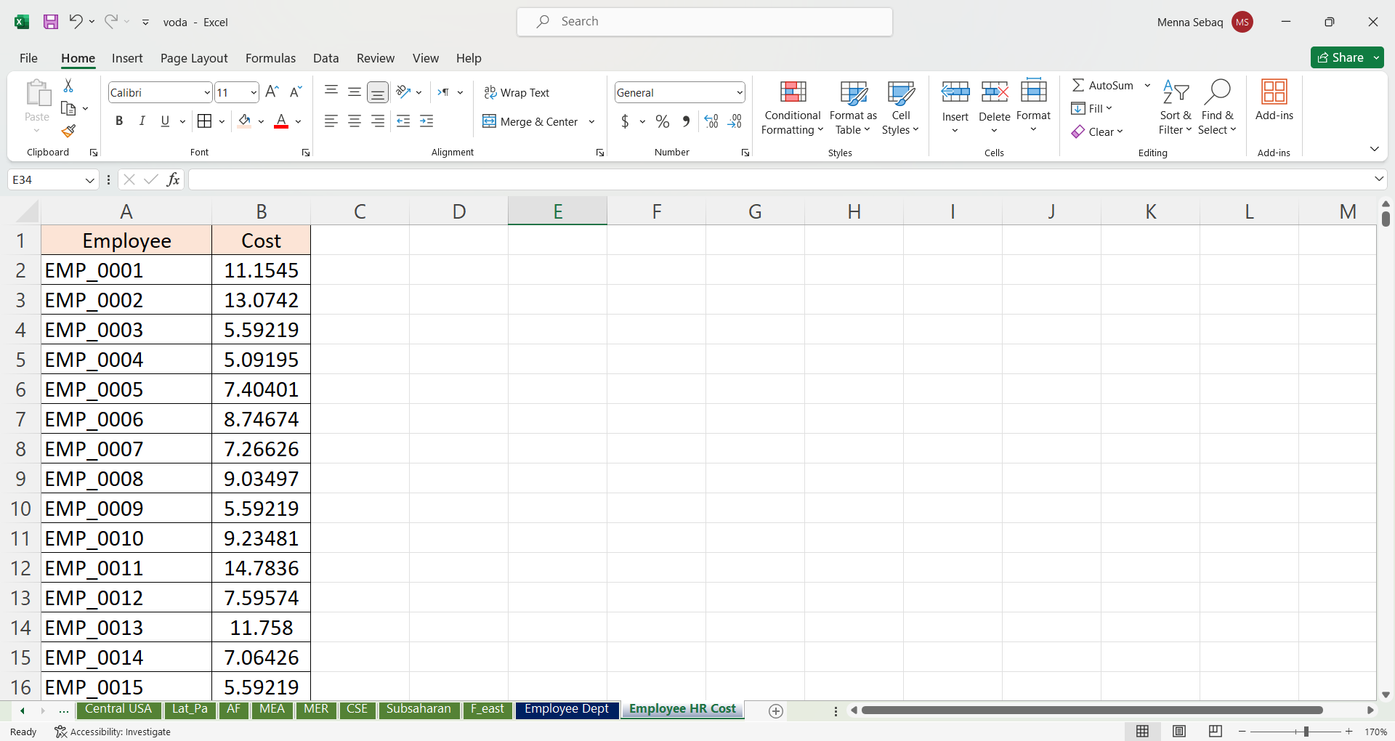
BEFORE MERGING
CHALLENGE

Slide 9
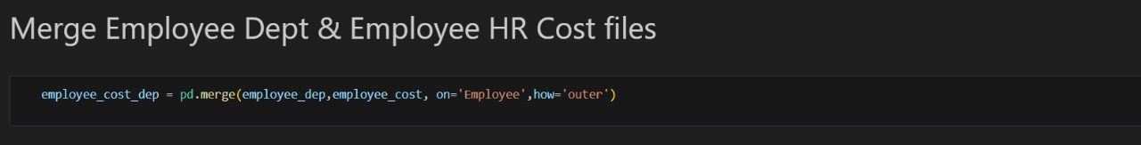
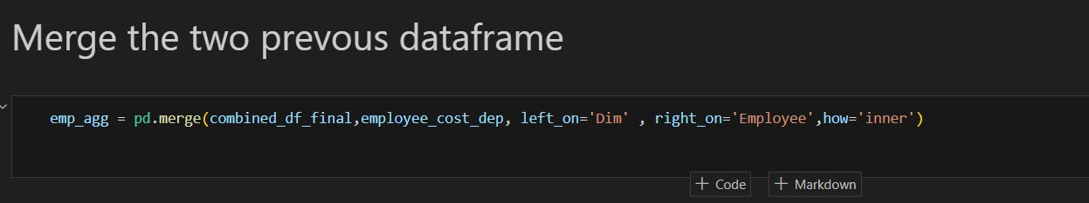
THE CODE TO MERGE

Slide 10
AFTER MERGING
SOLUTION

Slide 11
PREPROCESSING

Slide 12
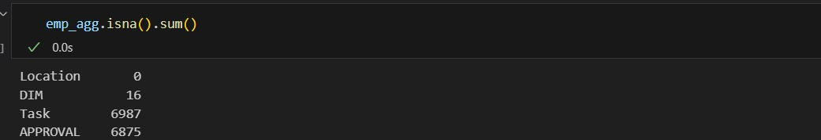

PREPROCESSING
Filled the null values with N/A

Slide 13
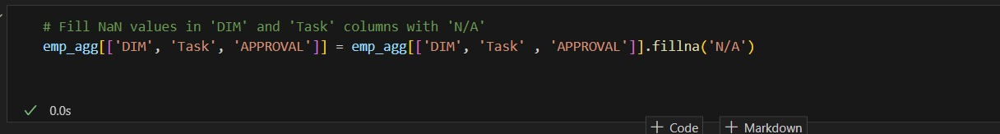
PREPROCESSING
Filled the null values with N/A

Slide 14
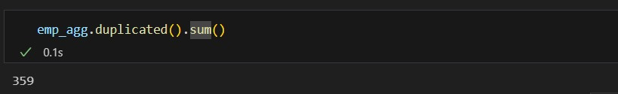
PREPROCESSING
Dropped the duplicate rows

Slide 15
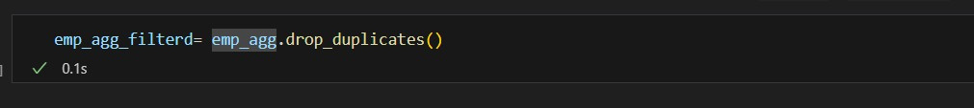
PREPROCESSING
Dropped the duplicate rows

Slide 16
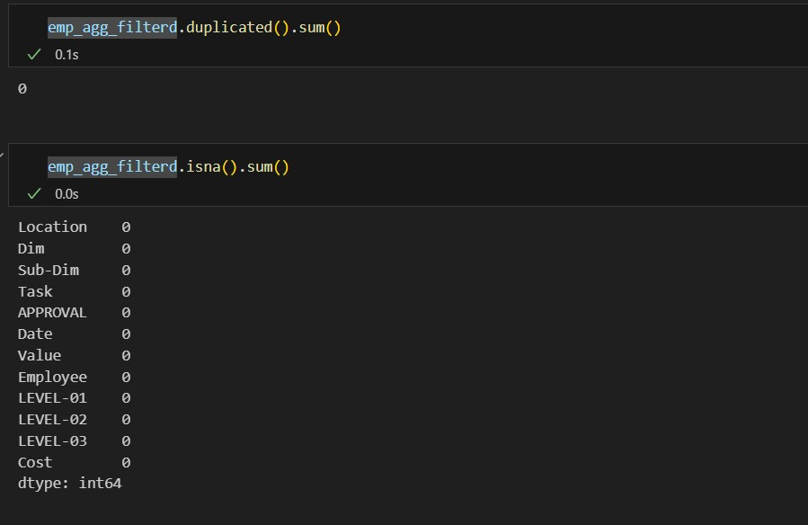
PREPROCESSING
The Result

Slide 17
ANALYSIS

Slide 18
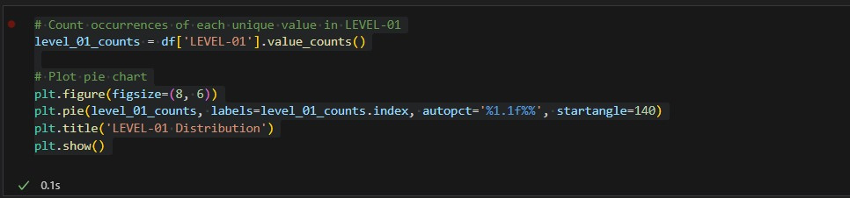
THE PIE CHART CODE

Slide 19
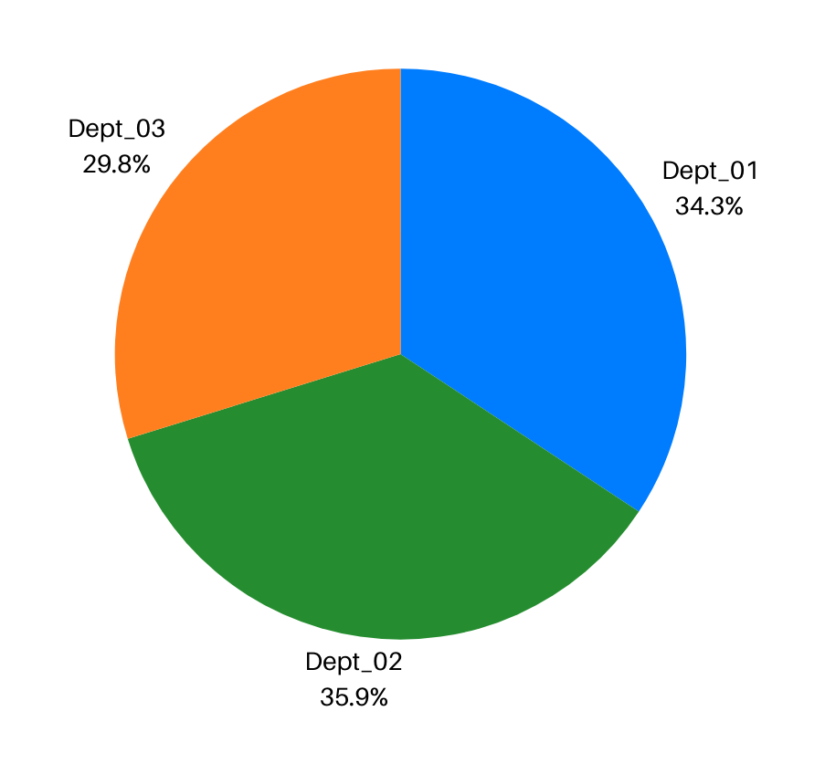
LEVEL-01
Likely represents a broad category or department that the employee belongs to

Slide 20
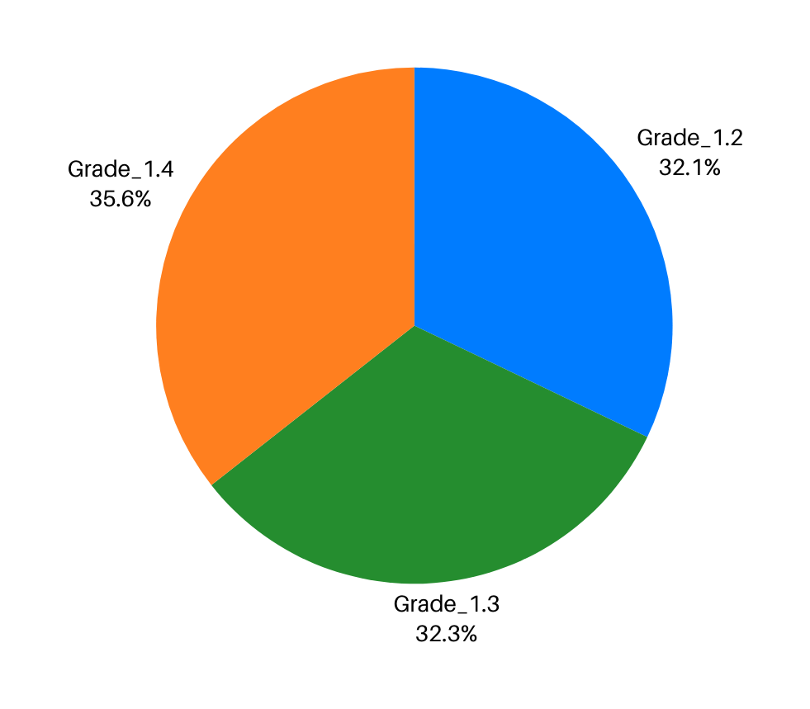
LEVEL-02
Provides a more specific classification within that broad category, such as a job grade or role

Slide 21
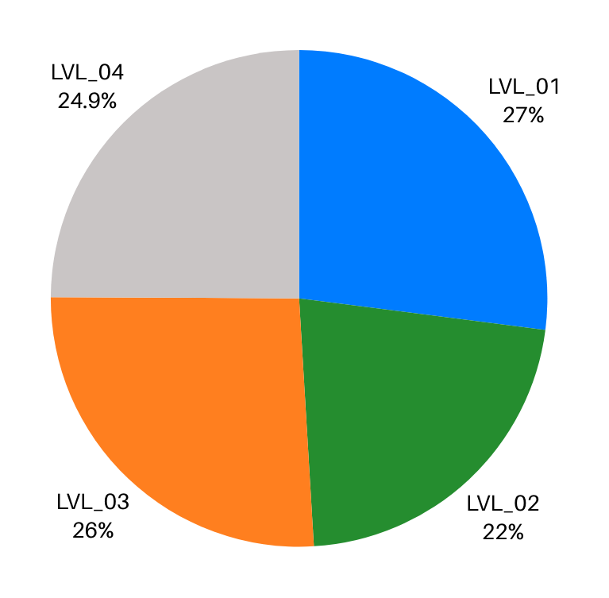
LEVEL-03
Offers an even finer level of detail, such as a specific position, team, or additional sub-classification

Slide 22
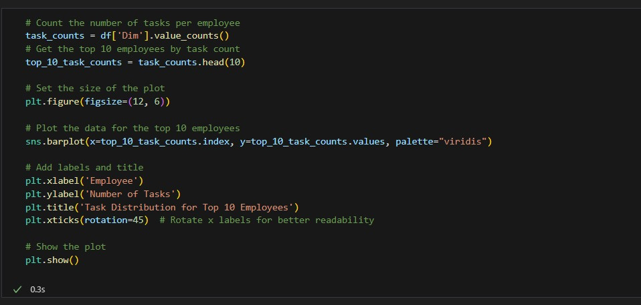
THE BAR CHART CODE
Task Distribution by Employee

Slide 23
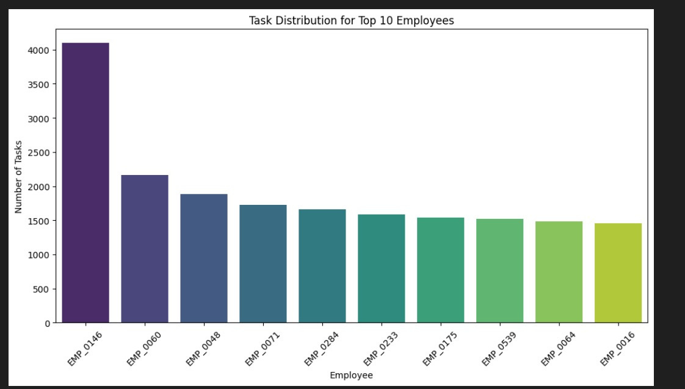
Task distribution for top 10 employees
Purpose: Identify workload distribution and check if any employee is overloaded with tasks

Slide 24
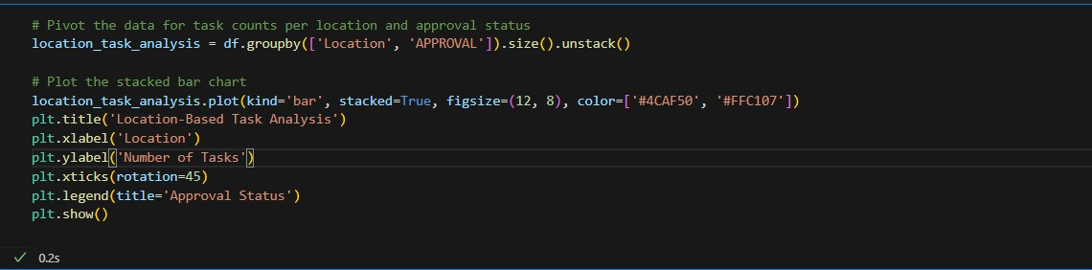
THE BAR CHART CODE
Location-Based Task

Slide 25
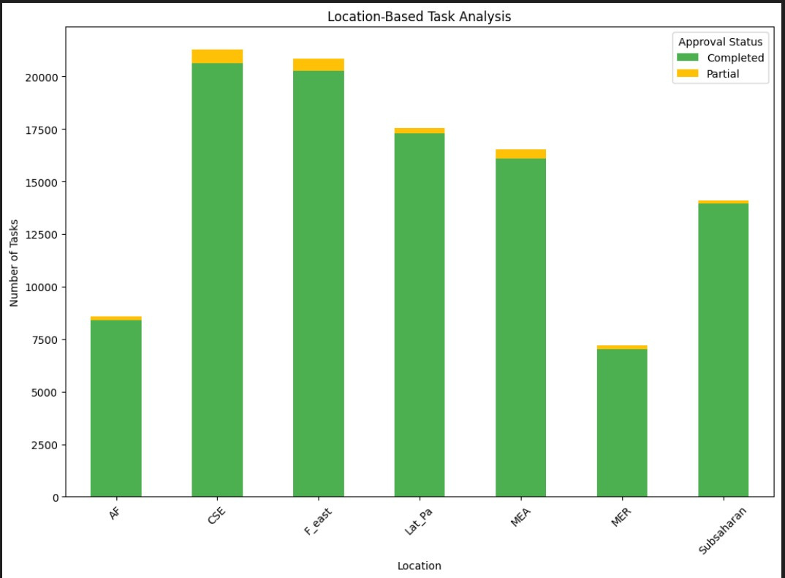
Location-Based Task
Purpose: Understand regional differences in task performance

Slide 26
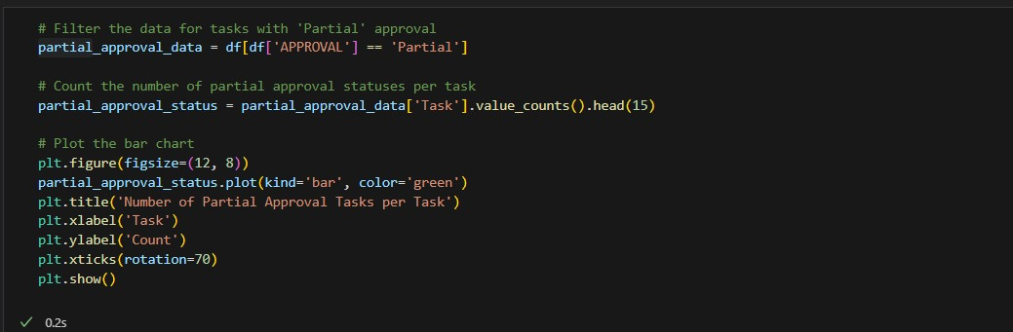
THE BAR CHART CODE
Approval partial Status Across Different Tasks

Slide 27
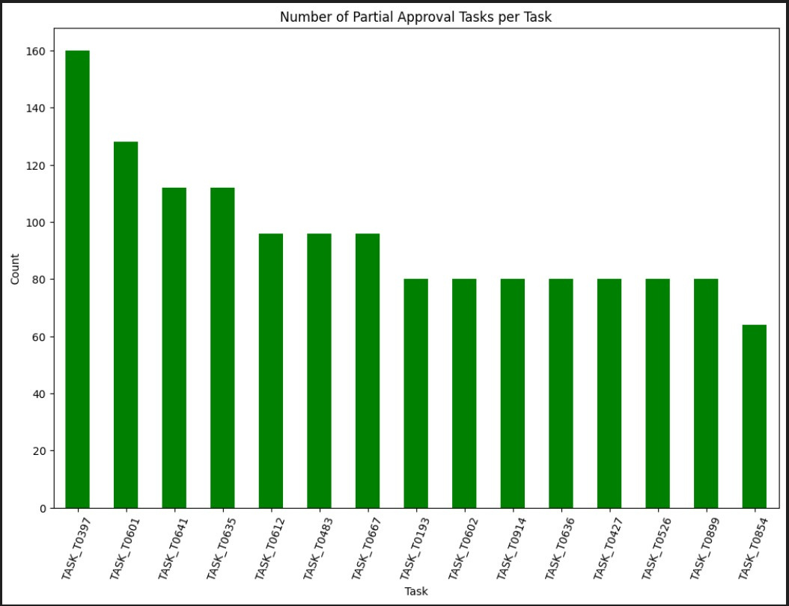
Approval partial Status Across Different Tasks
Purpose: Identify tasks that are lagging in approval

Slide 28
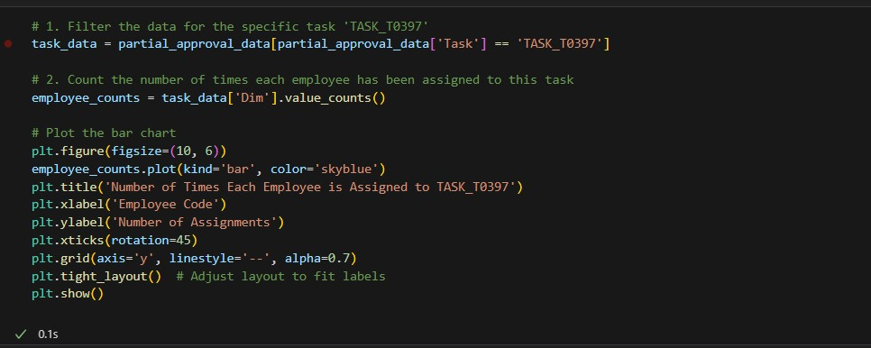
THE BAR CHART CODE
Employee Task Assignment in Partial Approval Status

Slide 29
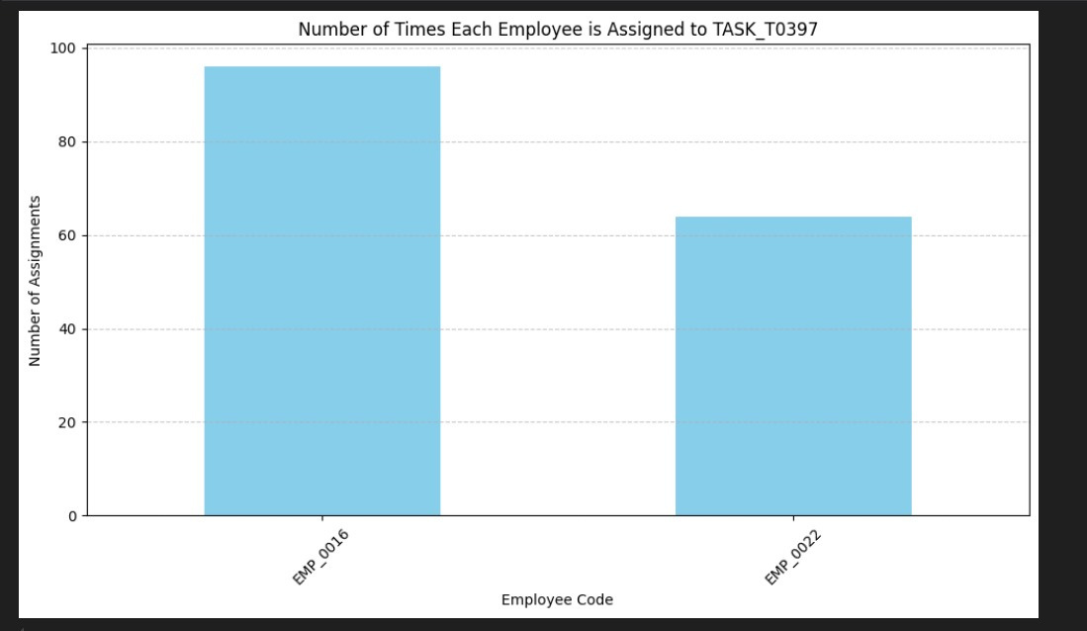
Employee Task Assignment in Partial Approval Status
Purpose: Identifies employees who are repeatedly assigned tasks that remain in partial approval status

Slide 30
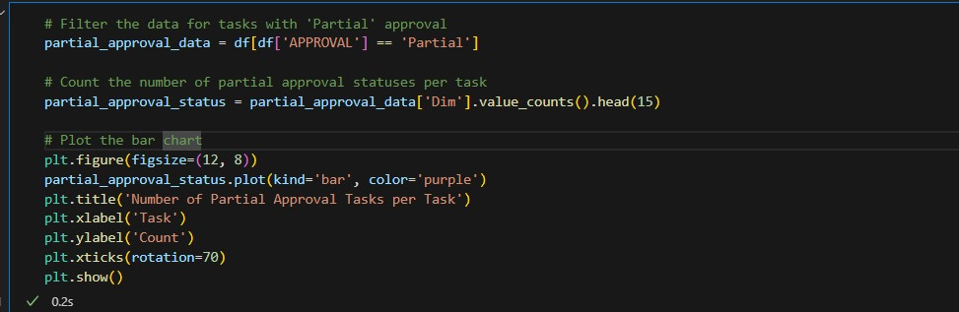
THE BAR CHART CODE
Task partial Rate by Employee

Slide 31
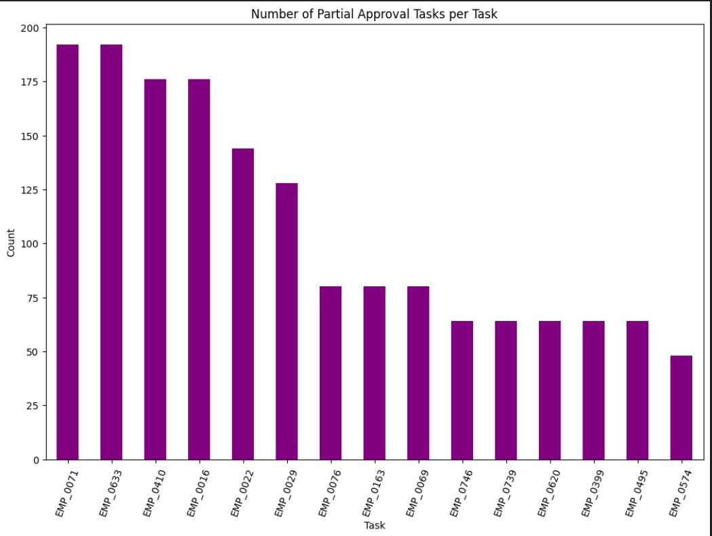
Task partial Rate by Employee
Purpose: Identify employees that are lagging in approval status

Slide 32
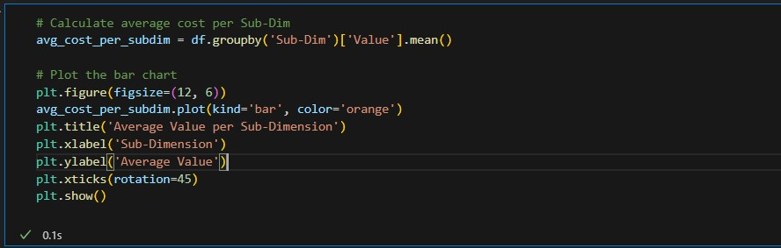
THE BAR CHART CODE
Sub-Dimension vs. Value Analysis

Slide 33
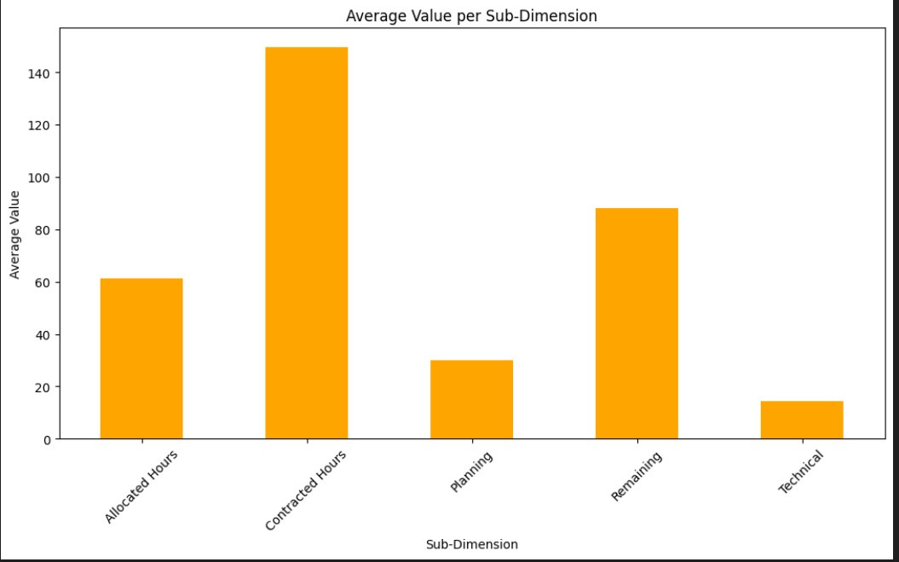
Sub-Dimension vs. Value Analysis
Purpose: Calculates the average value associated with each sub-dimension, providing insights into how resources or efforts are distributed across different categories

Slide 34
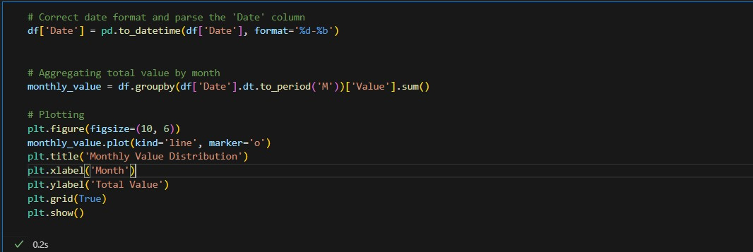
THE TREND CHART CODE
Monthly Value Trends

Slide 35
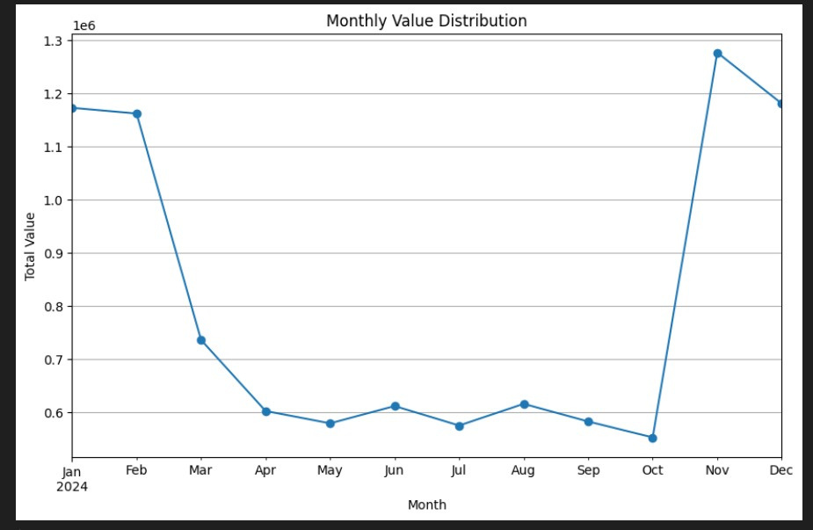
Monthly Value Trends
Purpose: Calculates the average value associated with each sub-dimension, providing insights into how resources or efforts are distributed across different categories

Slide 36

Thank You

